Slide 1
Socket Programming Assignment EE4204 – Sem 2 AY 2018-2019
Sivaraman Vignesh (PhD Student)
Assoc. Prof. Mohan Gurusamy
Electrical and Computer Engineering Department
National University of Singapore

Slide 2
Sockets
Application Programming Interface (API)
Interface between an application and network
Application creates a socket
The interface defines the following operations
Create a socket
Attach a socket to the network
Send/receive messages through a socket
Close a socket

Slide 3
Socket – Family and Type
Socket Family
PF_INET : Internet Family
PF_UNIX: Unix Pipe facility
Socket Type
SOCK_STREAM: byte stream such as TCP
SOCK_DGRAM: message oriented service such as UDP

Slide 4
Example 1
Develop a socket program in UNIX/Linux that uses (i) TCP as the transport protocol and (ii) UDP as the transport protocol for transferring a short message between a client and server. The client sends a string (input by the user) to the server and the server prints the string on the screen after receiving it.

Slide 5
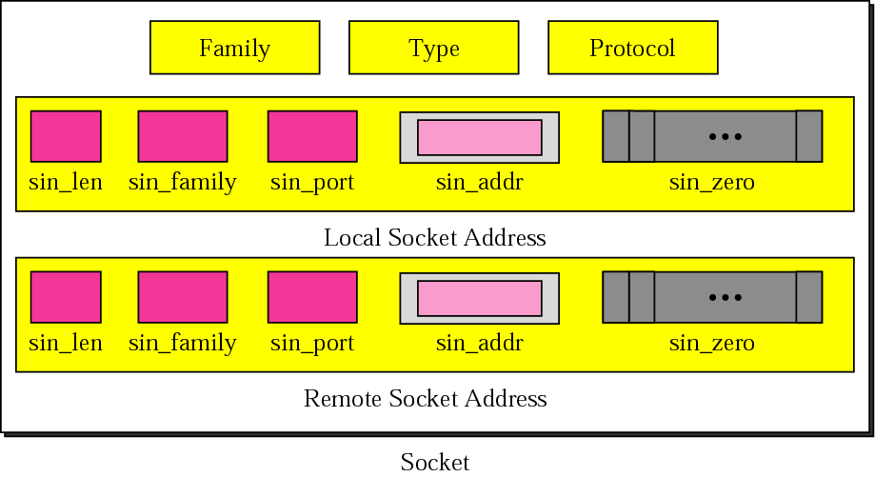
Socket structure
© The McGraw-Hill Companies, Inc., 2000

Slide 6
UDP Client
Create a socket
Chosen by the system
© The McGraw-Hill Companies, Inc., 2000

Slide 7
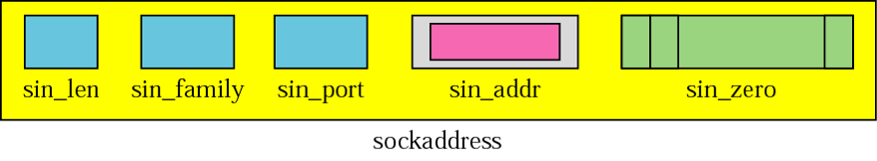
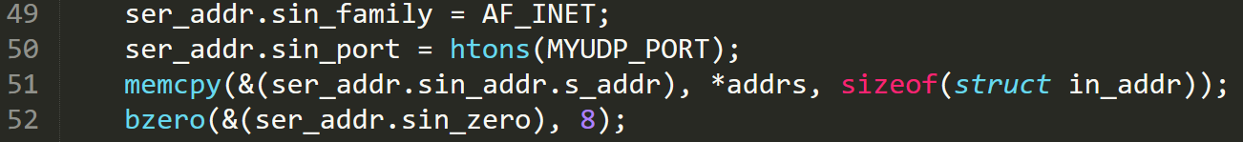
UDP Client
Get the server address
Has information like name, aliases, address type etc
© The McGraw-Hill Companies, Inc., 2000
Send data to the server
Server address(remote socket)

Slide 8
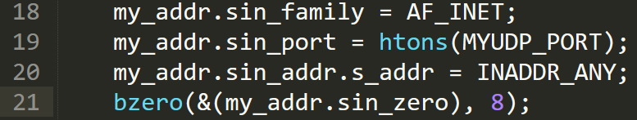
UDP Server
Creating socket is same as the client
Values of the other tuples
In case the system has multiple IPs
© The McGraw-Hill Companies, Inc., 2000

Slide 9
UDP Server
Bind function: Associates the socket with the given local address
Receive from client
Client address (remote socket)
Close the socket (both at server and client)

Slide 10
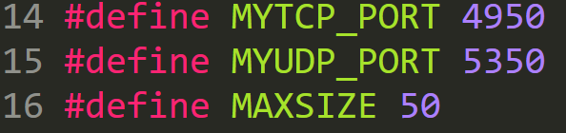
headsock.h (Ex 1)

Slide 11
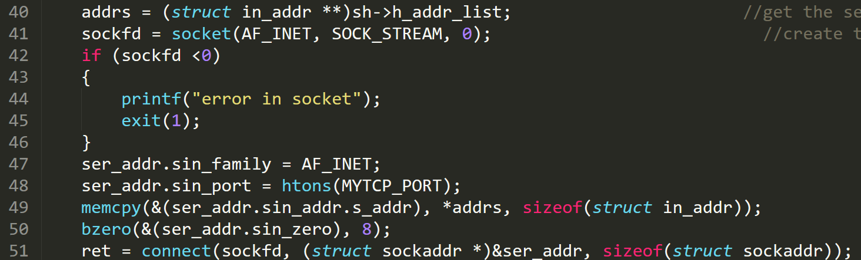
Example 1 (TCP): Client
Server address (from command line)
Creating a socket and connecting to it

Slide 12
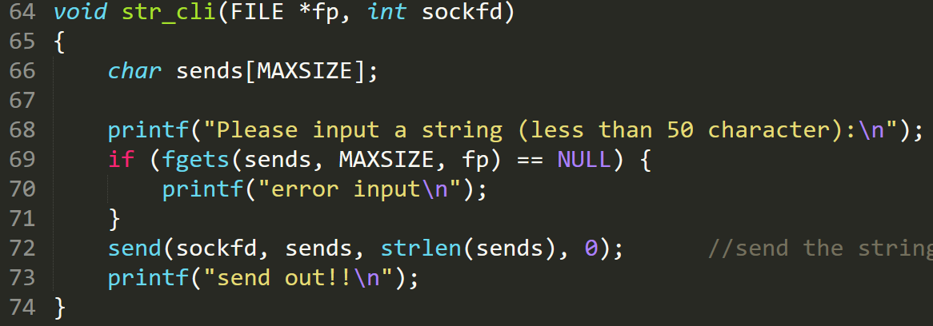
Example 1 (TCP): Client
Client application to send a string to the server

Slide 13
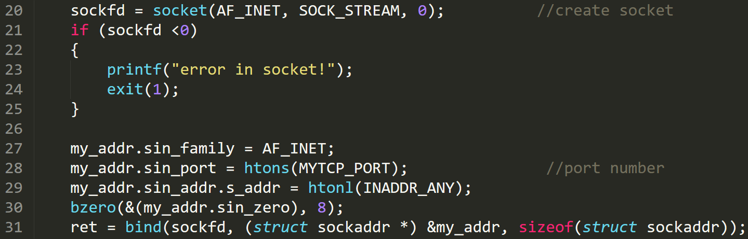
Example 1 (TCP): Server
Create a socket at the server

Slide 14
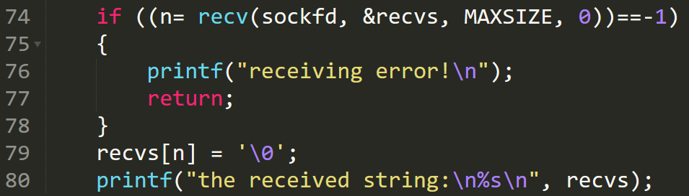
Example 1 (TCP): Server
Informs the OS, that socket is ready for requests
Connect to an incoming request
Server application to receive a string from a client

Slide 15
Example 2
Develop a TCP-based client-server socket program for transferring a large message. Here, the message transmitted from the client to server is read from a large file. The entire message is sent by the client as a single data-unit. After receiving the file, the server sends an ACK message to the receiver. Verify if the file has been sent completely and correctly by comparing the received file with the original file (“diff” command could be used). Measure the message transfer time and throughput.

Slide 16
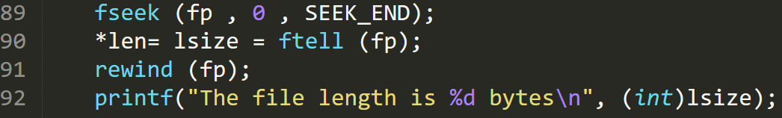
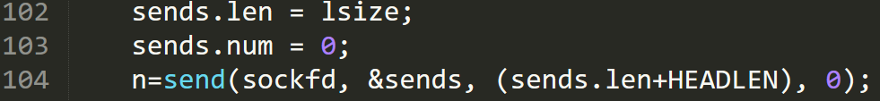
Example 2: Client
The TCP connection process is same as Example 1
Open the file in read mode
Determine the length of the file
Read the file into the buffer
Send the file to the server

Slide 17
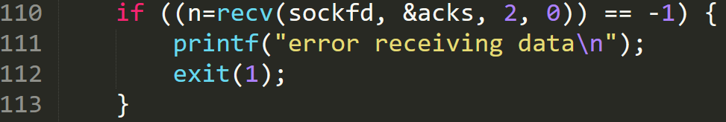
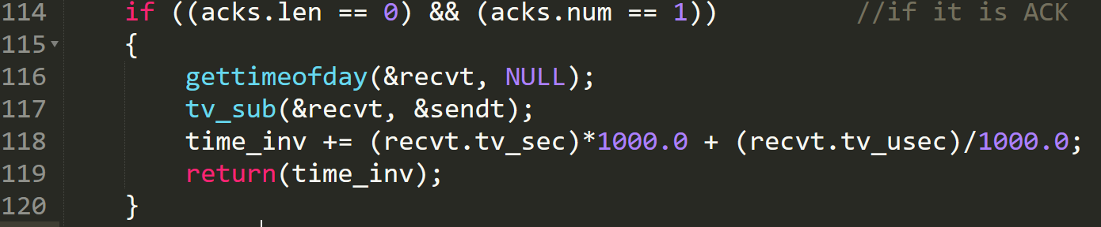
Example 2: Client
Wait for the ack
Check if it is an Ack and calculate the time taken

Slide 18
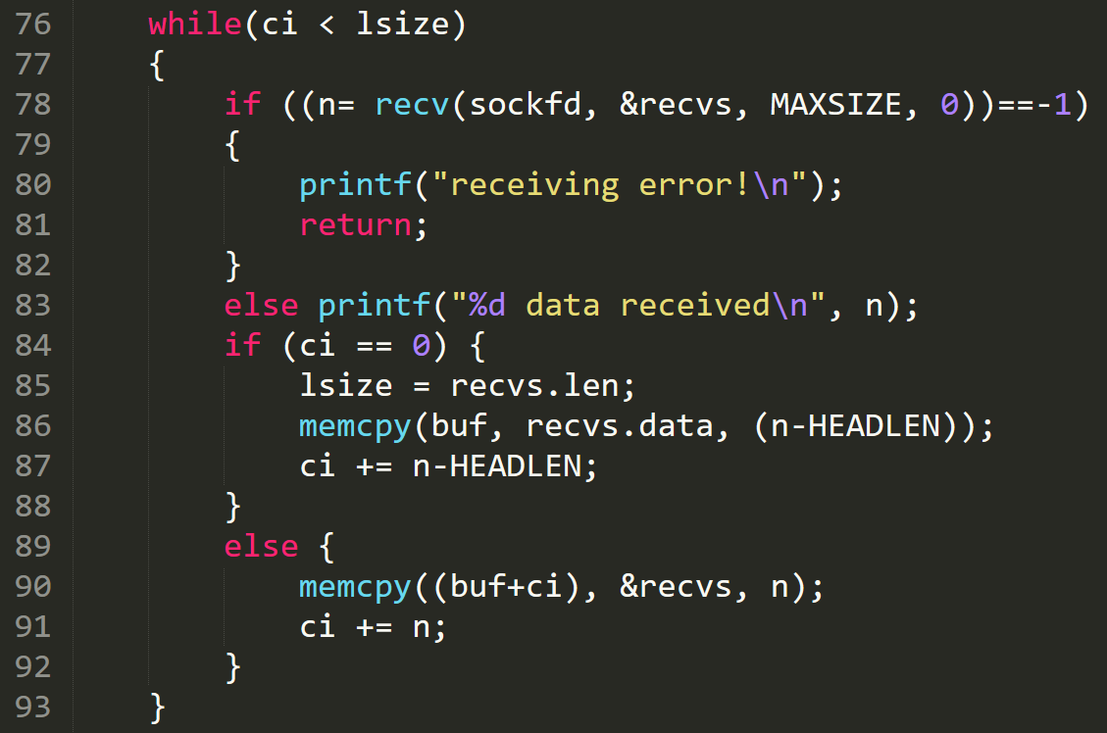
Example 2: Server
Receive the whole file from client

Slide 19
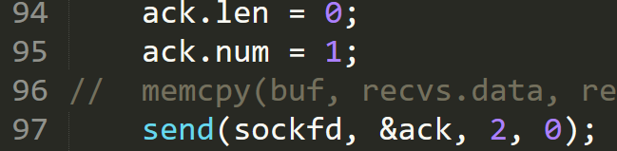

Example 2: Server
Send ack to client after receiving the whole file
Save the file from buffer to a file

Slide 20
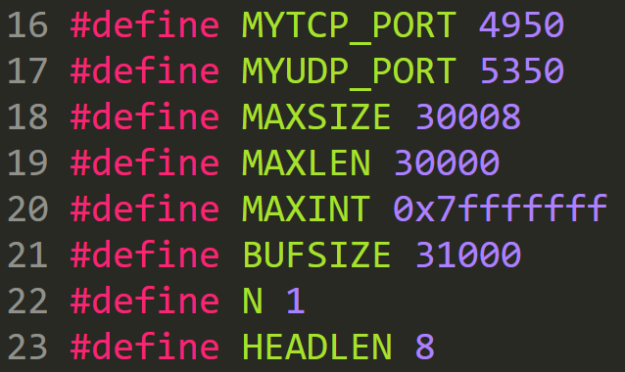
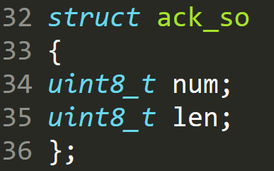
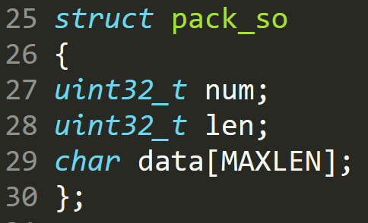
headsock.h (Ex 2)

Slide 21
Example 3
Develop a TCP-based client-server socket program for transferring a large message. Here, the message transmitted from the client to server is read from a large file. The message is split into short data-units which are sent one by one without waiting for any acknowledgement between transmissions of two successive data-units. Verify if the file has been sent completely and correctly by comparing the received file with the original file. Measure the message transfer time and throughput for various sizes of data-units.

Slide 22
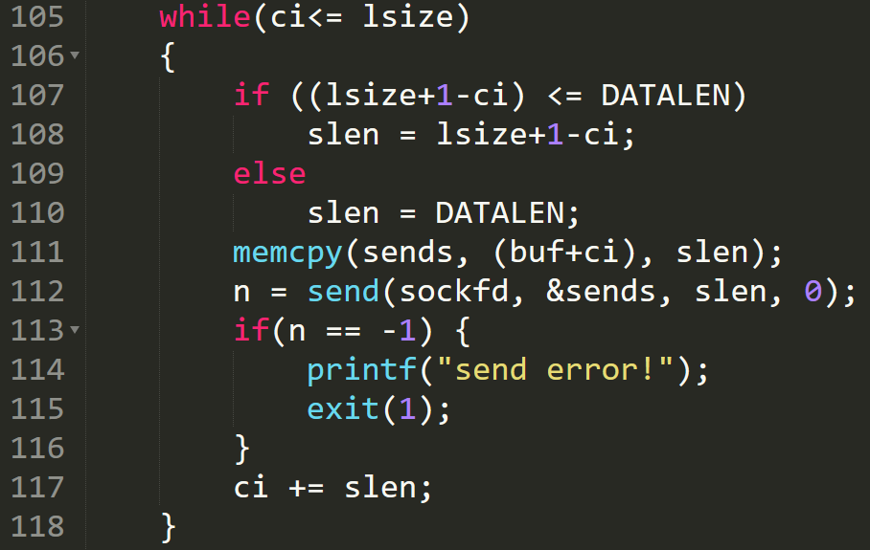
Example 3: Client sending file in data units
Sending file in data units of size DATALEN

Slide 23
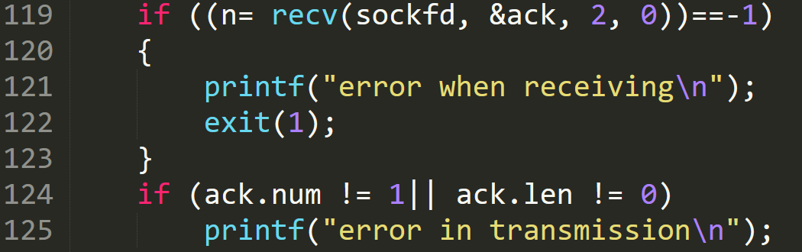
Client waits for Ack

Slide 24
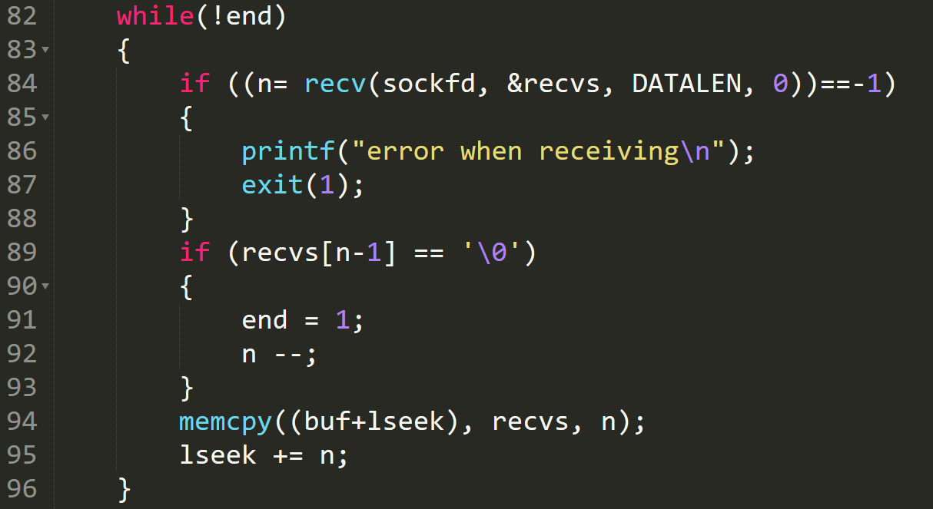
Example 3: Server receiving file in data units
Receiving file in data units of size DATALEN

Slide 25
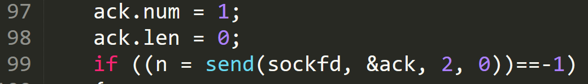

Server sending Ack and saving the file
Send ack to client
Save the file from buffer to a file

Slide 26
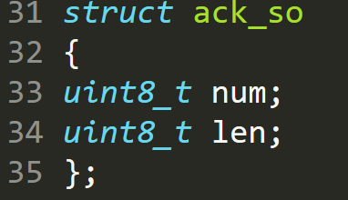
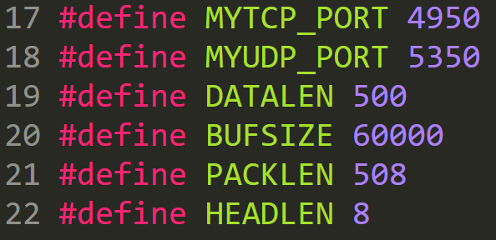
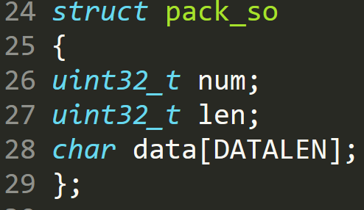
headsock.h (Ex 3)

Slide 27
Sample Assignment problem
Develop a UDP-based client-server socket program for transferring a large message. Here, the message transmitted from the client to server is read from a large file. The message is split into short data-units (DUs) which are sent and acknowledged in alternating batches of size 1 and 2 DUs. The sender sends one DU, waits for an acknowledgment (ACK); sends two DUs, waits for an acknowledgement; and repeats the above procedure until the entire file is sent. The receiver sends an ACK after receiving a DU; sends next ACK after receiving two DUs; and repeats the above procedure.

Slide 28
Sample Assignment problem (contd.)
Verify if the file has been sent completely and correctly by comparing the received file with the original file. Measure the message transfer time and throughput for various sizes of data-units and compare it with the stop-and-wait protocol where the batch size is always fixed to be 1. Choose appropriate values for “data unit size” and measure the performance. Repeat the experiment several times and plot the average values in a report with a brief description of results, assumptions made, etc.

Slide 29
Assignment problem
Send a file from client to server using UDP.
Server acks the data units in alternating batches of 1 and 2 data units (Dus).
Compare the performance with Stop and Wait.
Send 1
Ack
Rcv 1
Ack
Ack
Send 2 DUs
Ack
Rcv 2 DUs
Client states
Server states

Slide 30
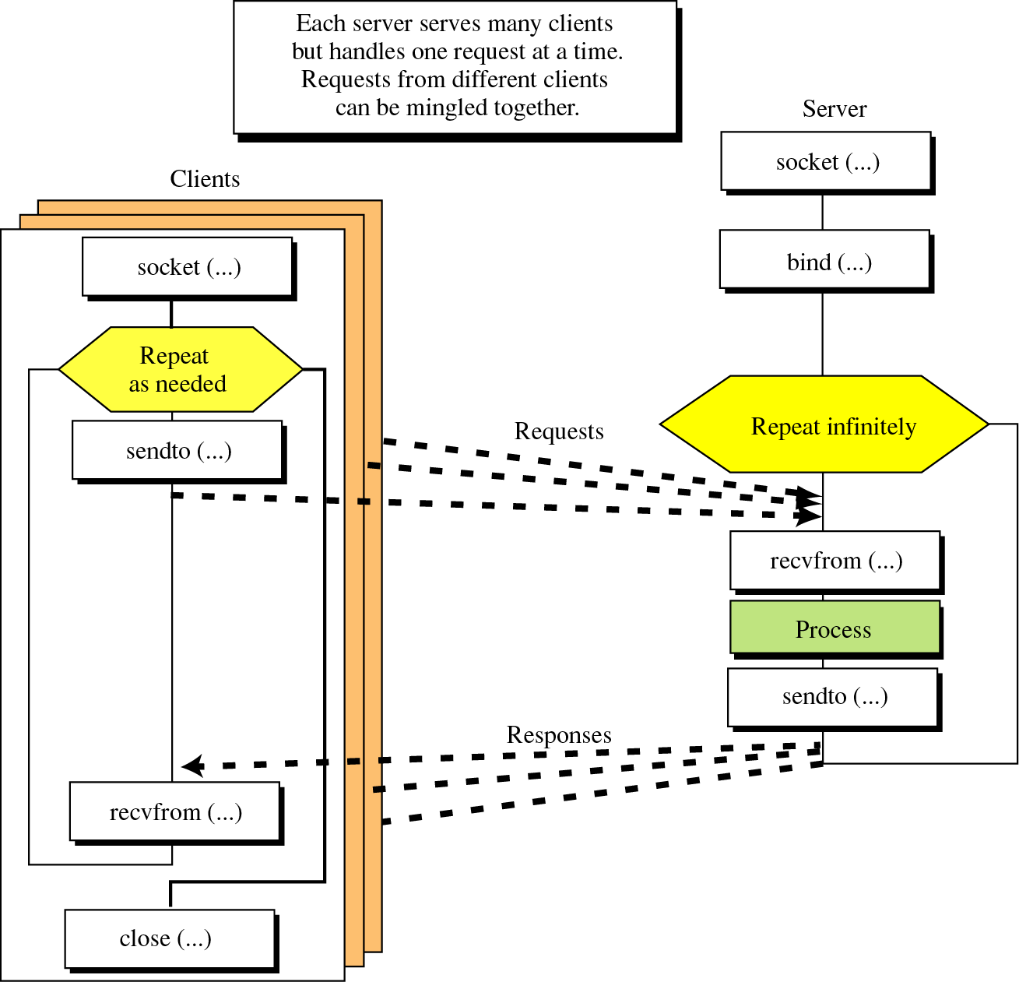
Connectionless iterative communication using UDP
© The McGraw-Hill Companies, Inc., 2000

